Slide 1


Assimilation of Machine Learning and Cloud Computing for Supply Chain Industry.

Slide 2





Everything Else Is Heavily Reliant On This Industry
- healthcare, retail, shale oil, automobile
Shifting End Markets and Regional Supply Chains
- EU, US to India, Chain, Brazil, South Africa
WHY SUPPLY CHAIN INDUSTRY?
Big Data Analytics Will Change The Industry
faster, more flexible, more granular,
more accurate, more efficient
Online Shoppers Keep Coming
- Till 2021 over 2.14 billion online shoppers

Slide 3
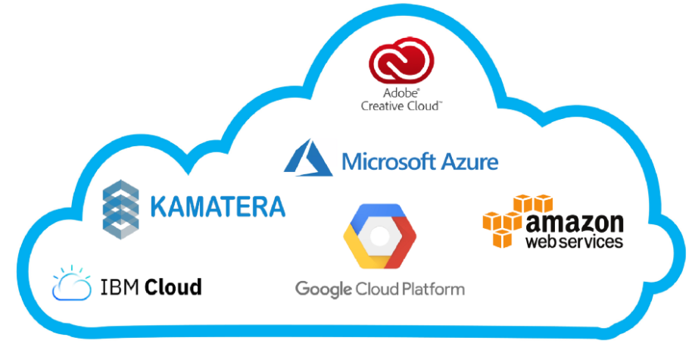
Cloud is about how you do computing, not where you do computing ~Paul Maritz, CEO of VMware
Benefits of Cloud
Efficiency/cost reduction
Data Security
Scalability
Mobility
Disaster recovery
Control
Competitive Edge
“The cloud services companies of all sizes…The cloud is for everyone. The cloud is a democracy.” ~Marc Benioff, Founder, CEO and Chairman of Salesforce
“With the cloud, individuals and small businesses can snap their fingers and instantly set up enterprise-class services.” ~ Roy Stephan, Founder and CEO of PierceMatrix

Slide 4

WHAT is Machine Learning?
- Automating automation
- Getting computers to program themselves
- Writing software is the bottleneck
- Let the data do the work instead!
“A breakthrough in machine learning would be worth
ten Microsofts” (Bill Gates, Chairman, Microsoft)
“Machine learning is going to result in a real revolution” (Greg Papadopoulos, CTO, Sun)
“Machine learning is today’s discontinuity”
(Jerry Yang, CEO, Yahoo)

Slide 5
Traditional Programming
Machine Learning
Sample Applications
Web Search
Computational Biology
Finance
Space Exploration
Robotics
E-commerce
Information Extraction
Social Networks
Debugging
Healthcare
Data
Computer
Output
Program
Data
Computer
Types of Learning
Supervised (inductive) Learning
-Training data includes desired outputs
Unsupervised Learning
Training data does not include desired outputs
Semi-supervised Learning
Training data includes a fixed desired outputs
Reinforcement Learning
Rewards from sequence of actions
Program
Output

Slide 6
Research Questions
To what extent cloud computing and machine learning techniques be effectively assimilated with supply chain industry to predict fraud and sales?
What will be Obstacles and Opportunities for applying machine learning and data mining techniques in the supply chain industry?
Which variables and features are important for Fraud Detection and Sales Prediction?
Which model is the best fit for Fraud Detection and Sales Prediction?
Aim of research is to study how Machine Learning models are helpful in fraud prediction and sales prediction.
Setting up the services of AWS which will make the implementation of predictive analysis easier and efficient.
Perform EDA (Exploratory Data Analysis) for generating preliminary insights from the dataset.
Evaluate and validate results of ML models using metrics like Accuracy, F1, Recall Score and RMSE, MAE values.
Feature engineering to obtain the impact of important features in the dataset.

Slide 7
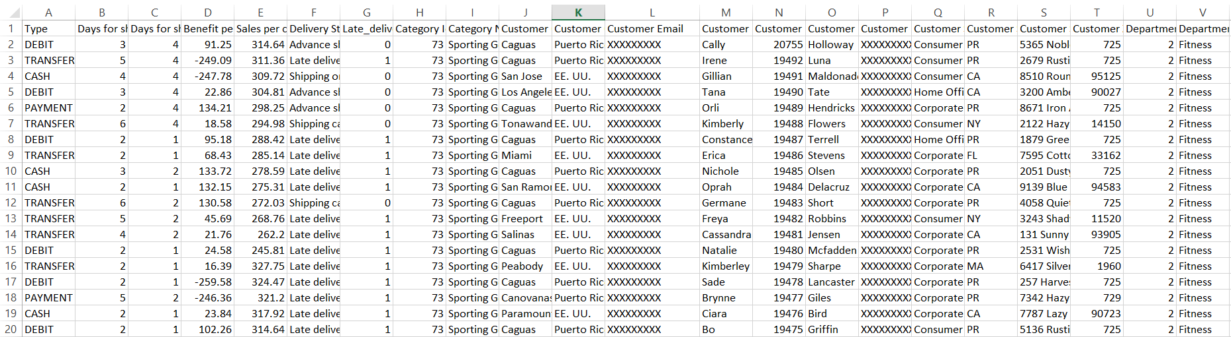
Dataset
Source: Dataset was first uploaded on Share & Manage Research Datasets –
Mendeley, 2019. Constante, Silva and Pereira, 2019 are the contributors of the dataset
Shape: 180,519 observations and 53, 24 object, 15 float64 and 14 int64 variables
Sample:
Target variable: ‘fraud’ for classification ‘Sales’ for regression

Slide 8
Research Methodology
Data Collection
Data Grasp
Data Pre-processing
Evaluation Metrics
AWS Services
Algorithms
Boto3, smart_open, pandas, os
Using EDA and descriptive analysis
SMOTE, StandardScaler, LabelEncoder
S3,SageMaker,EC2
Confusion Matrix, RMSE, MAE, ROC_AUC
Classification & Regression

Slide 9
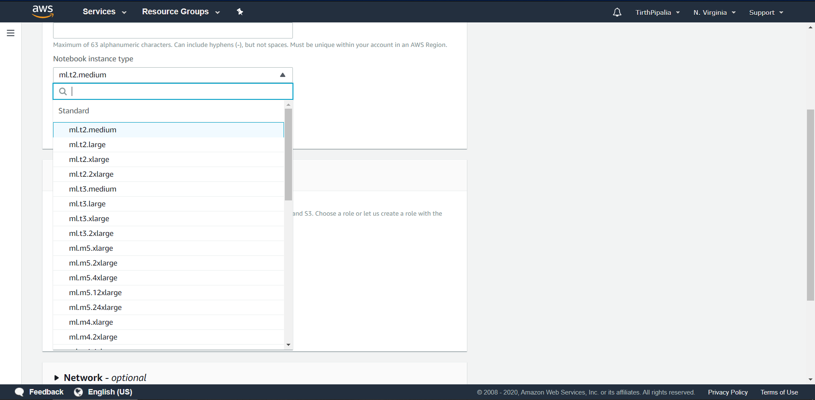
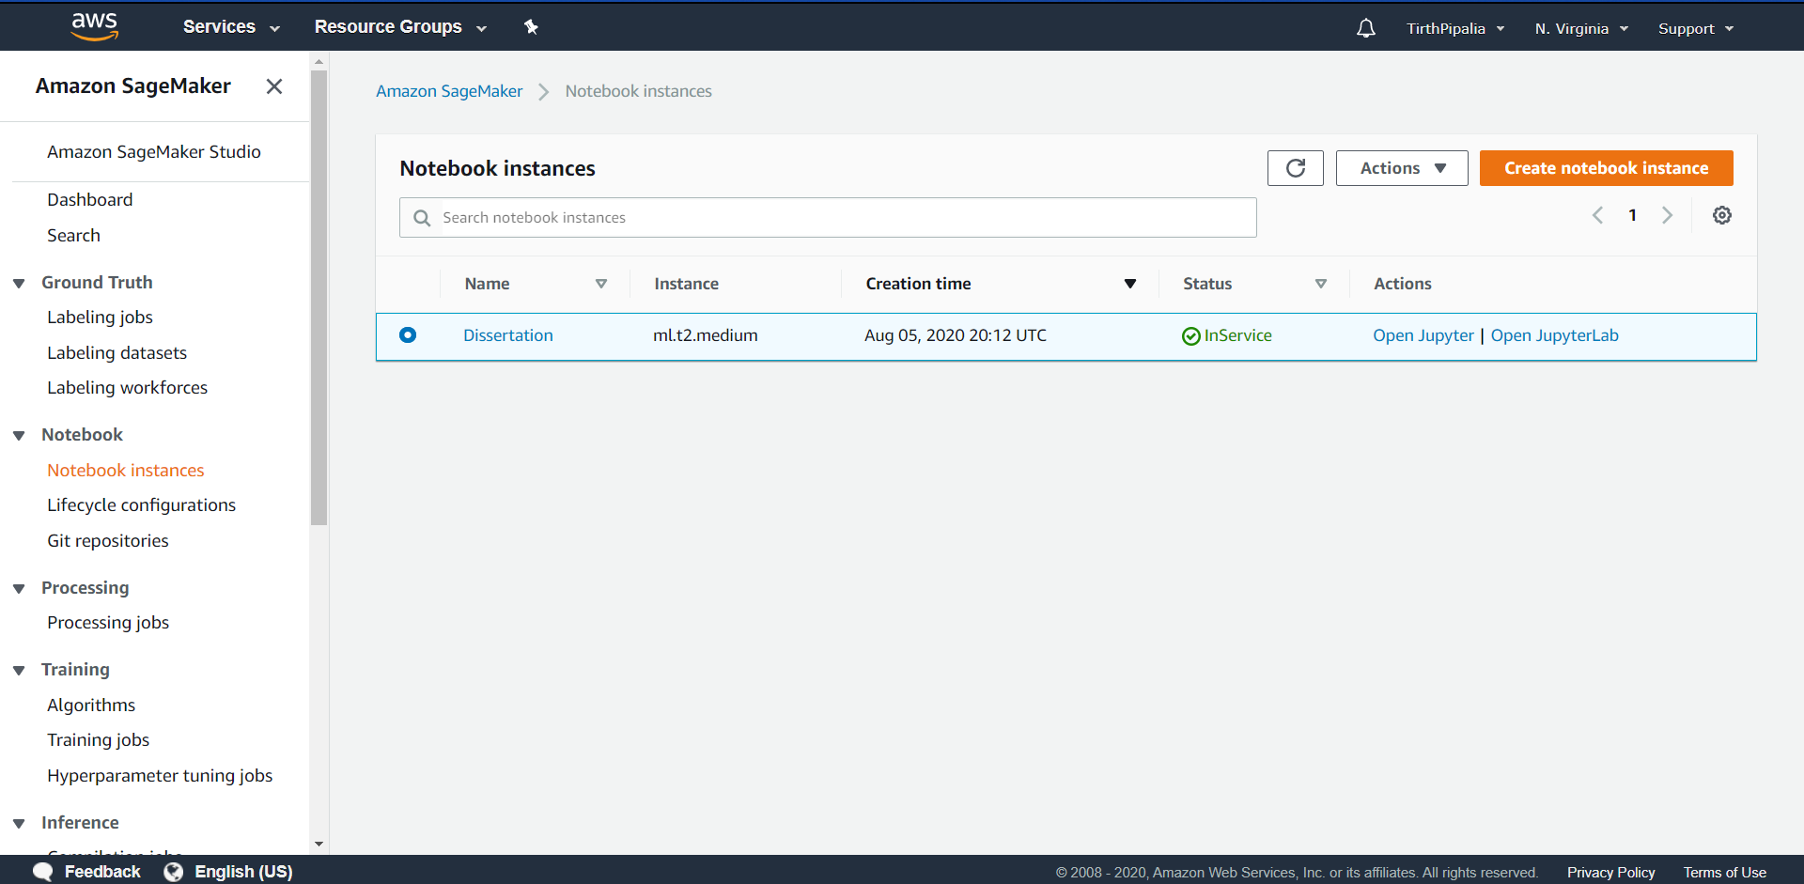
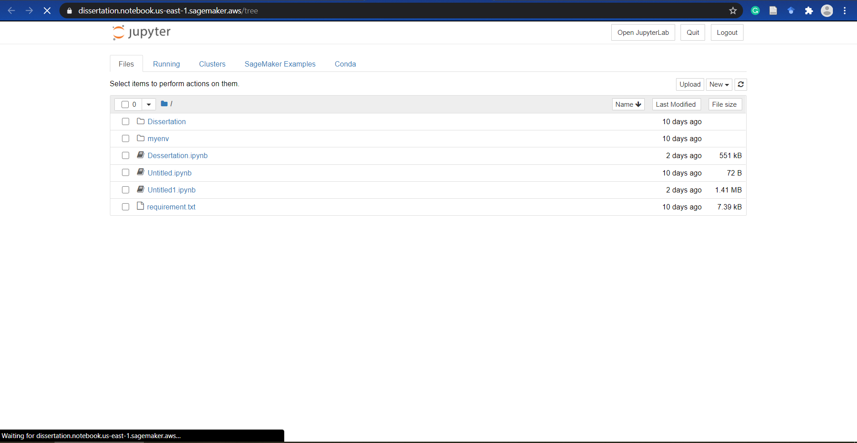
AWS SageMaker
Login to AWS Account
Select SageMaker service
Create Notebook Instance
Select Instance Type
Launch Instance
Run Jupyter Notebook

Slide 10
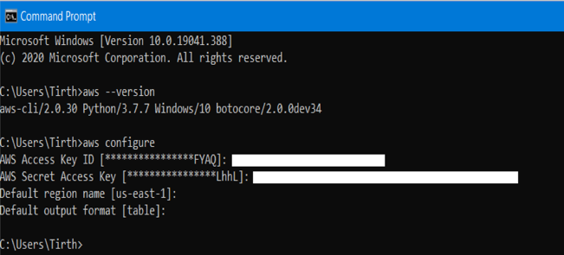
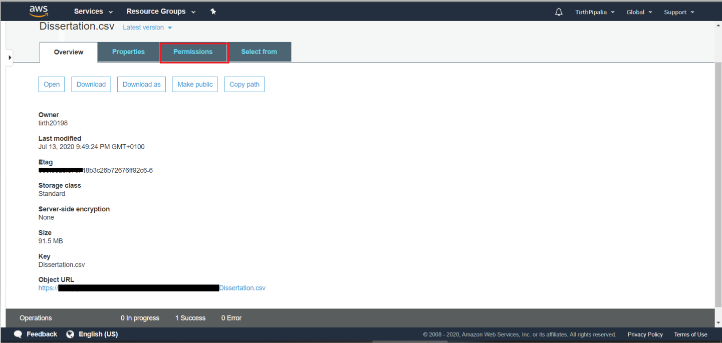
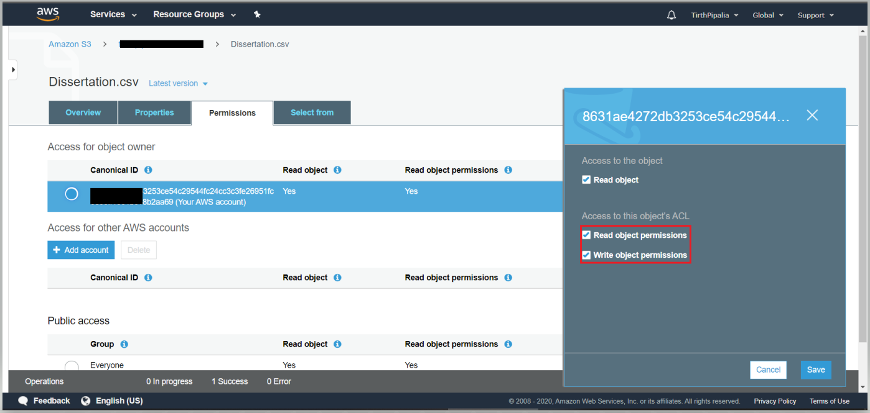
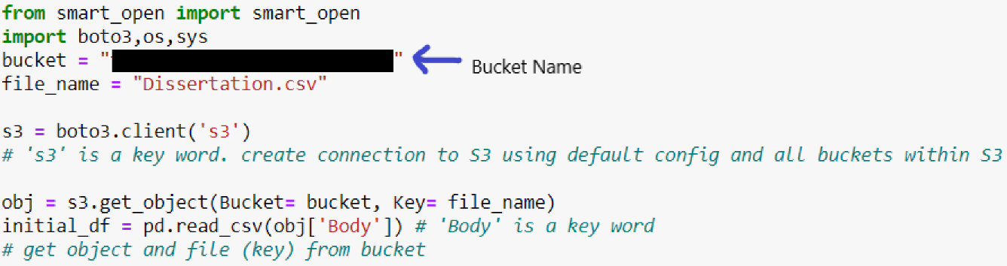
Amazon S3

Slide 11
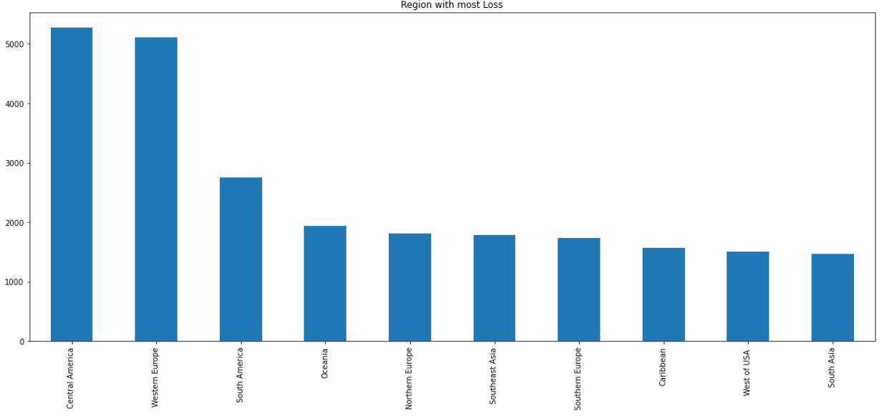
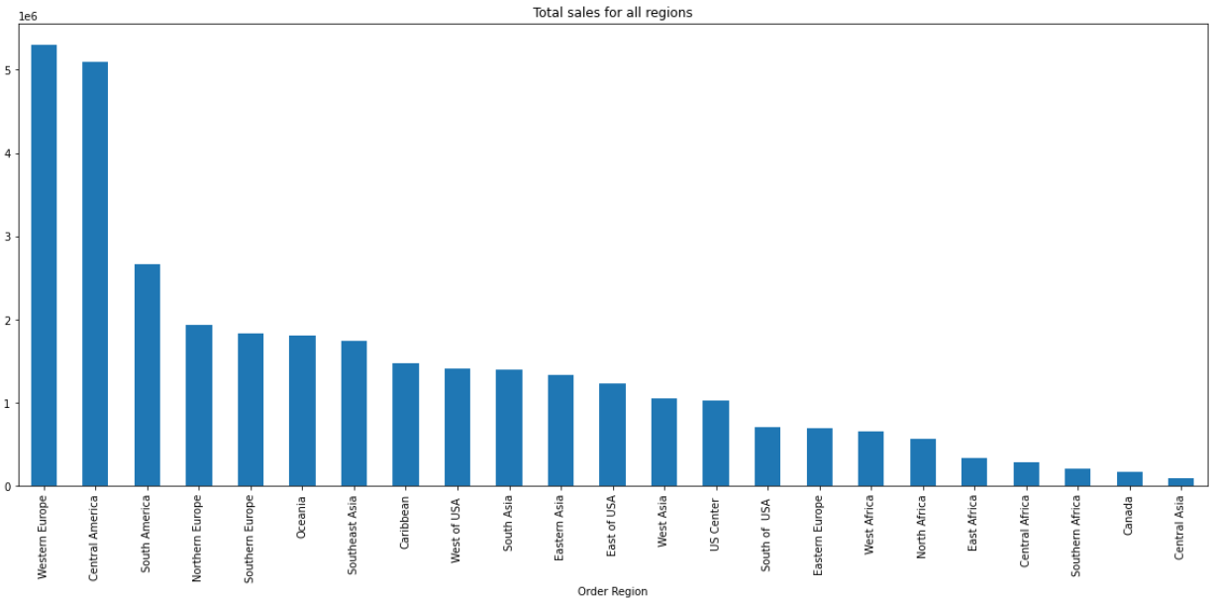
Exploratory Data Analysis
Region with Most Loss
Total Sales for All Region

Slide 12
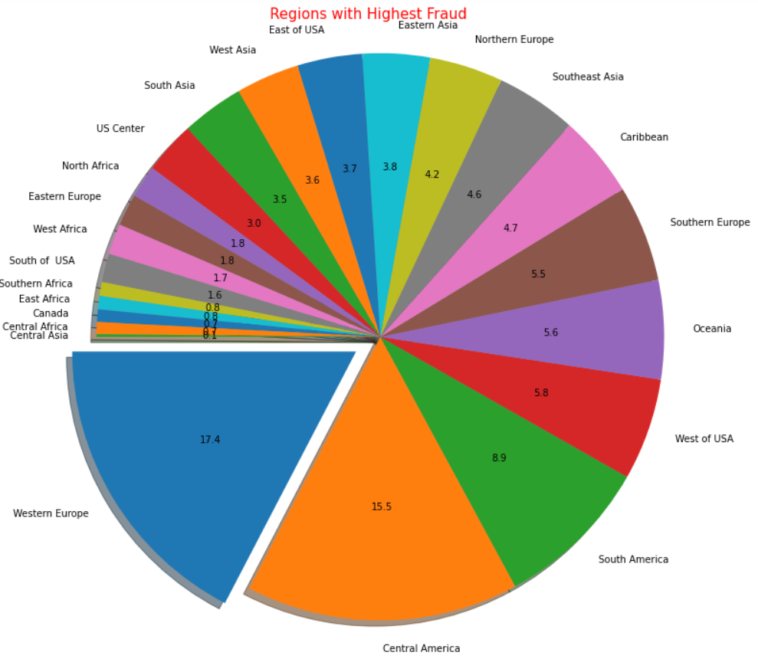
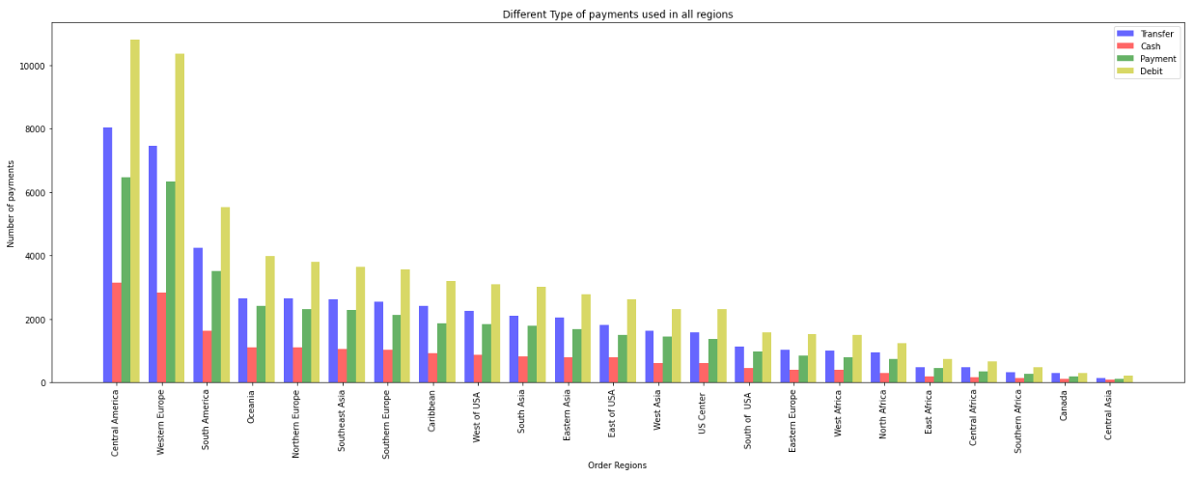
Exploratory Data Analysis

Slide 13
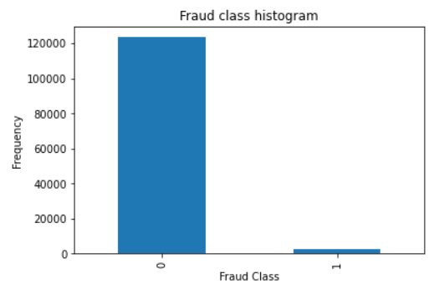
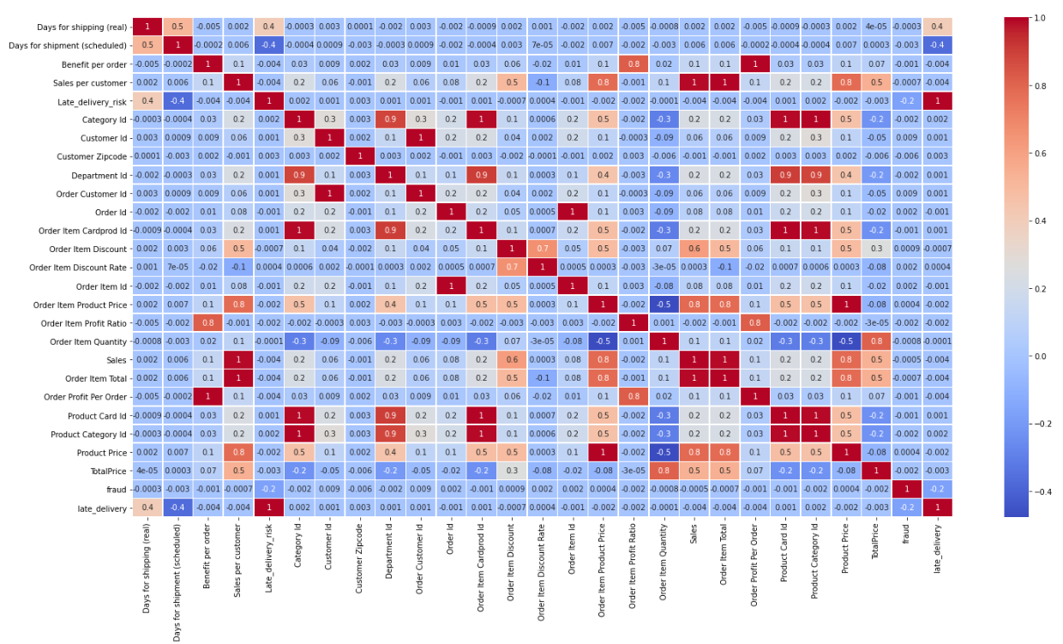
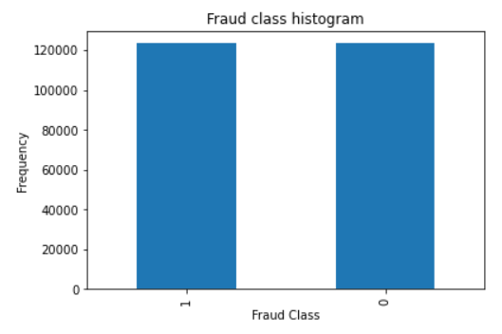
Data Pre-processing
SMOTE
Heat Map
For handling imbalanced data
For handling co-relationship between features of dataset

Slide 14
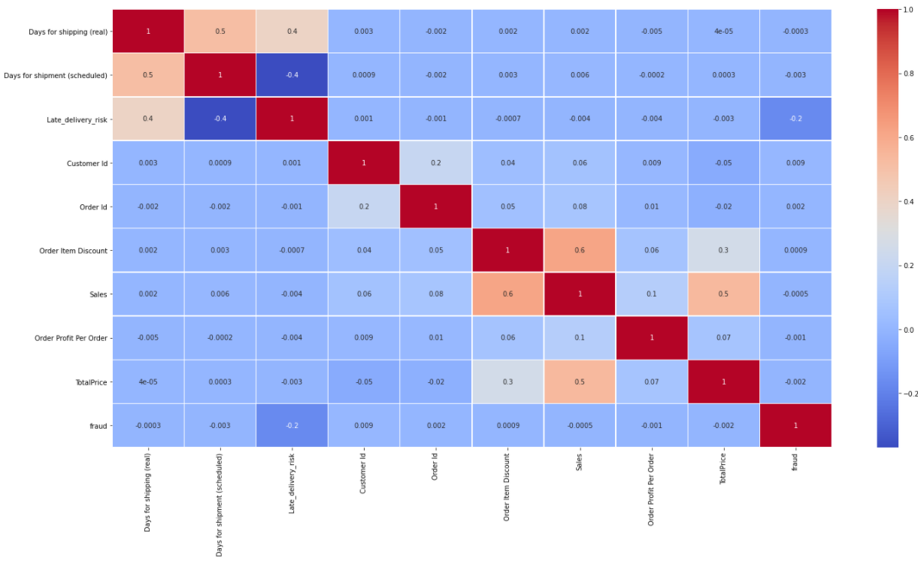
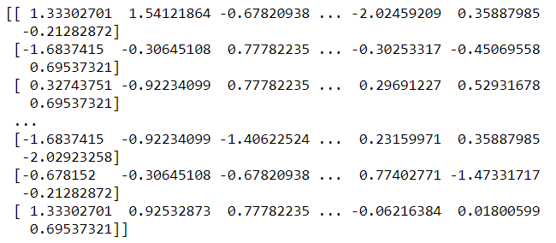
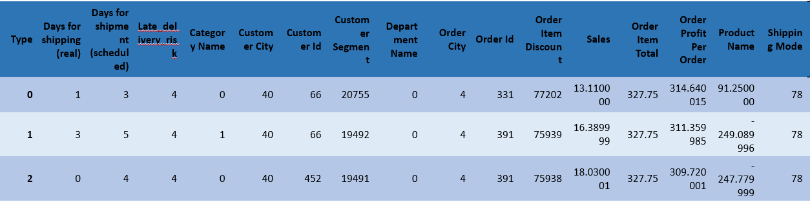
Data Pre-processing
Heat Map after Feature Selection and Handling Missing Values
Standard Scaler: To Standardize Data
Label Encoder: To convert Data in Numeric Form

Slide 15
Modeling
Classification Models
1. Decision Tree
Parameters: criterion='entropy', max_depth=4, max_features='sqrt', max_leaf_nodes=3,
min_samples_leaf=3, min_samples_split=7
2. Random Forest
Parameters: bootstrap=False, max_features='sqrt', min_samples_split=5, n_estimators=70, random_state=42
3. AdaBoost
Parameters: n_estimators=500
4. Linear Discriminant Analysis(LDA)
Parameters: solver='svd', n_components=1
5. Light GBM(Gradient boosted Model)
Parameters: boosting='gbdt', learning_rate=0.004, max_bin=500, max_depth=22, n_estimators=50, num_leaves=30, objective='binary'
Regression Models
LASSO regression
Ridge Regression
Gradient Boosted Tree
XGBoost
Linear Regression

Slide 16
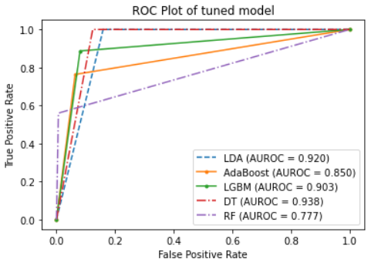
Model | Accuracy% | Recall% | F1% | ROC_AUC%
Random Forest | 98.3325947263461 | 65.9695817490 | 60.584897424 | 77.6681912342875
LDA | 84.4338577442942 | 12.8141483090 | 22.717271727 | 92.0346958444356
LightGBM | 91.8771696580249 | 20.5113848450 | 33.318174927 | 90.3260558668307
AdaBoost | 93.2306669621094 | 21.9032183375 | 34.041021950 | 84.9888818072763
Decision Tree | 88.8396484230740 | 16.2048108032 | 27.599425011 | 90.8604781548115
Classification Result
Model | Training Time(s) | Prediction Time(s) | Tuning time(s)
Random Forest | 65.774 | 0.296 | 1302
LDA | 0.615 | 0.0 | 5.4
Light GBM | 1.448 | 0.06 | 99.5
AdaBoost | 180.171 | 3.022 | 2352
Decision Tree | 0.308 | 0.016 | 17.4

Slide 17
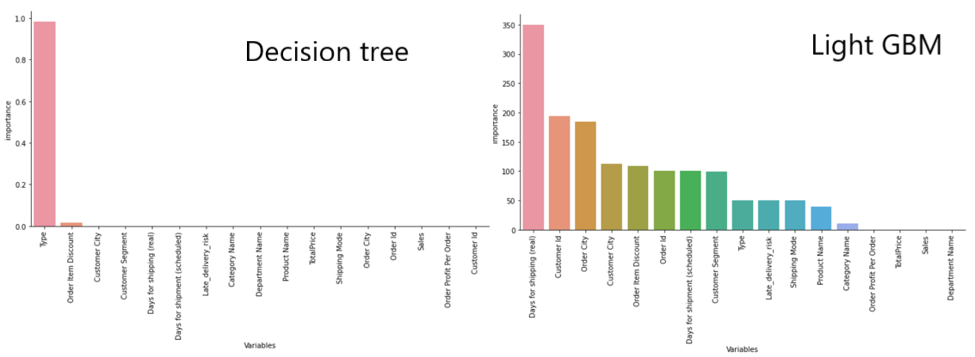
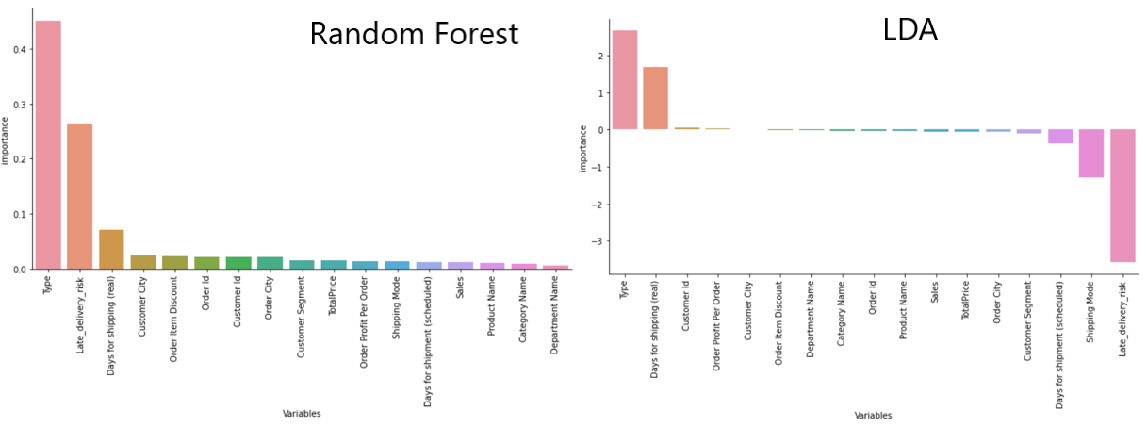
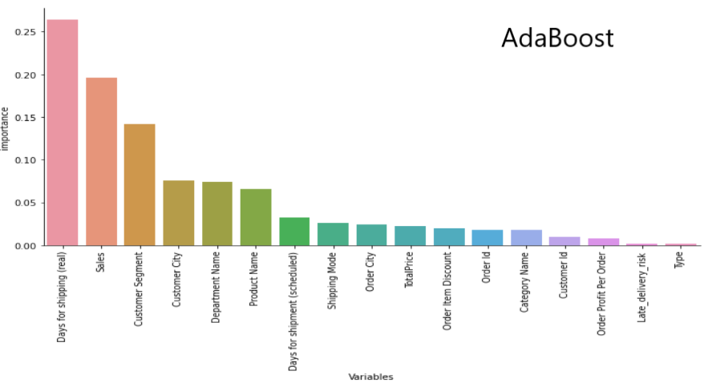
Important Features

Slide 18
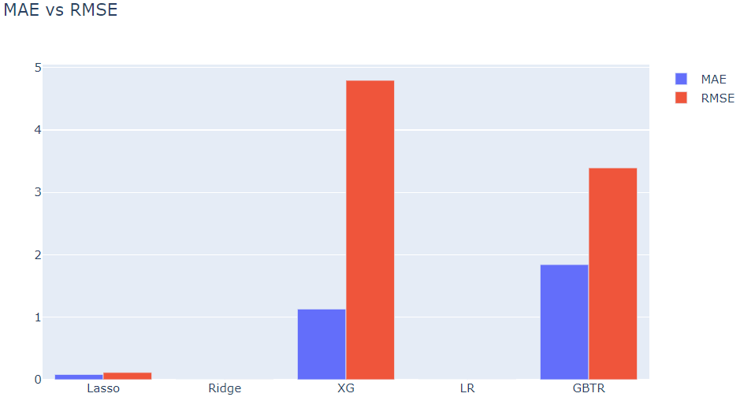
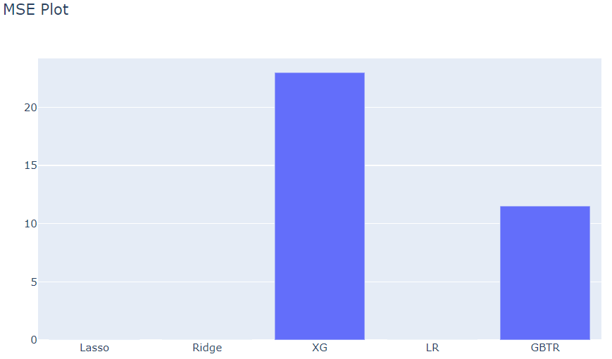
Model | MAE | RMSE
Lasso | 0.08339548200648535 | 0.11536865510851727
Ridge | 0.0010036470043190342 | 0.001882263872915812
XGBoost | 1.1313262058563323 | 4.793739223668036
Linear Regression | 0.0005448947680783427 | 0.0014938985645114012
Gradient Boosted Tree | 1.8431233686568962 | 3.392379767811959
Regression Result
Model | Training Time(s) | Prediction Time(s)
Lasso | 0.04 | 0.0
Ridge | 0.032 | 0.008
XGBoost | 19.919 | 0.775
Linear Regression | 0.08 | 0.0
Gradient Boosted Tree | 39.152 | 0.144

Slide 19
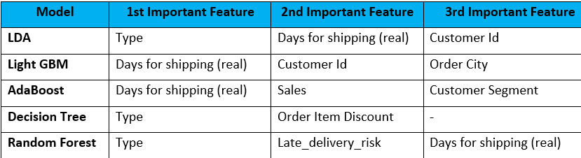
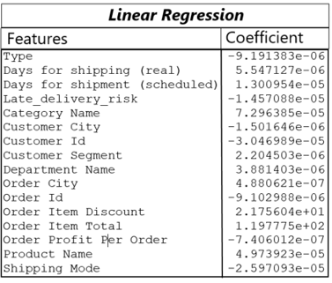
RESEARCH OUTCOME
Fraud Perdition
Best Model: Random Forest
Accuracy% | Recall% | F1% | ROC_AUC%
98.3325947263461 | 65.9695817490 | 60.584897424 | 77.6681912342875
Sales Prediction
Best Model: Linear Regression
MAE | RMSE
0.0005448947680783427 | 0.0014938985645114012

Slide 20
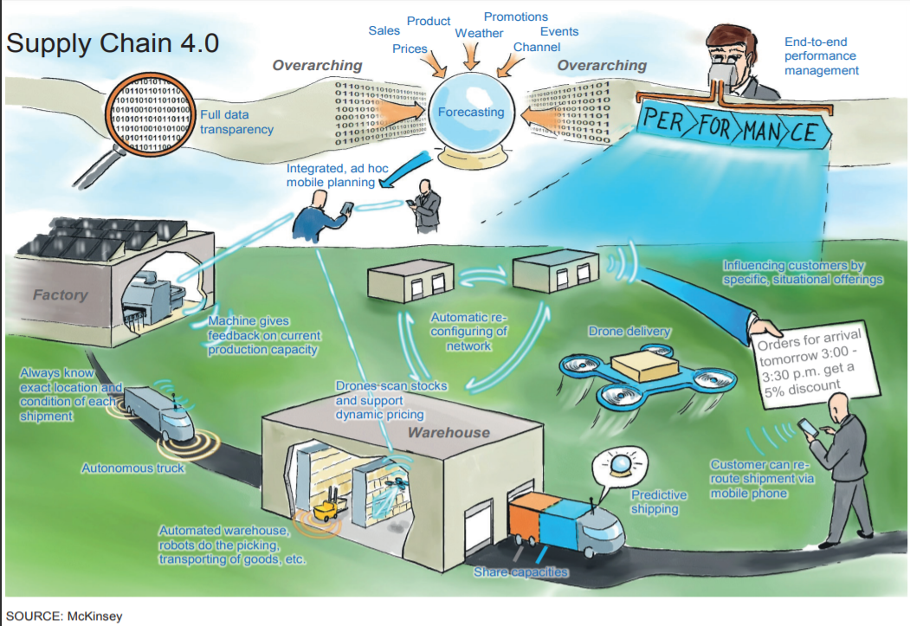

Thank you

